Slide 1

WEB TECHNOLOGIES – LECTURE 18
UNIVERSITÀ DEGLI STUDI DI NAPOLI FEDERICO II
SINGLE PAGE APPLICATIONS
Luigi Libero Lucio Starace, PhD
luigiliberolucio.starace@unina.it https://luistar.github.io https://www.docenti.unina.it/luigiliberolucio.starace

Slide 2
PREVIOUSLY, ON WEB TECHNOLOGIES
We learned how to develop traditional web applications
Using CGI, PHP, and plain Node.js
And using a Framework (Express)
In the web apps we developed, pages are dynamically generated on the server and sent to the web browser for rendering.
Once they reach the browser, web pages are inherently static.

Slide 3
MULTI-PAGE WEB APPLICATIONS
In our traditional web apps, when we change page (e.g.: click on a link):
A new request is sent to the server
The new page is returned in response and displayed by the browser This approach is also known as the multi-page approach, leading to
multi-page web applications.
Back in Lecture 7, we learned about JavaScript in a Browser environment: DOM manipulation, fetching data, …
So far, however, we did not make particular use of those features

Slide 4
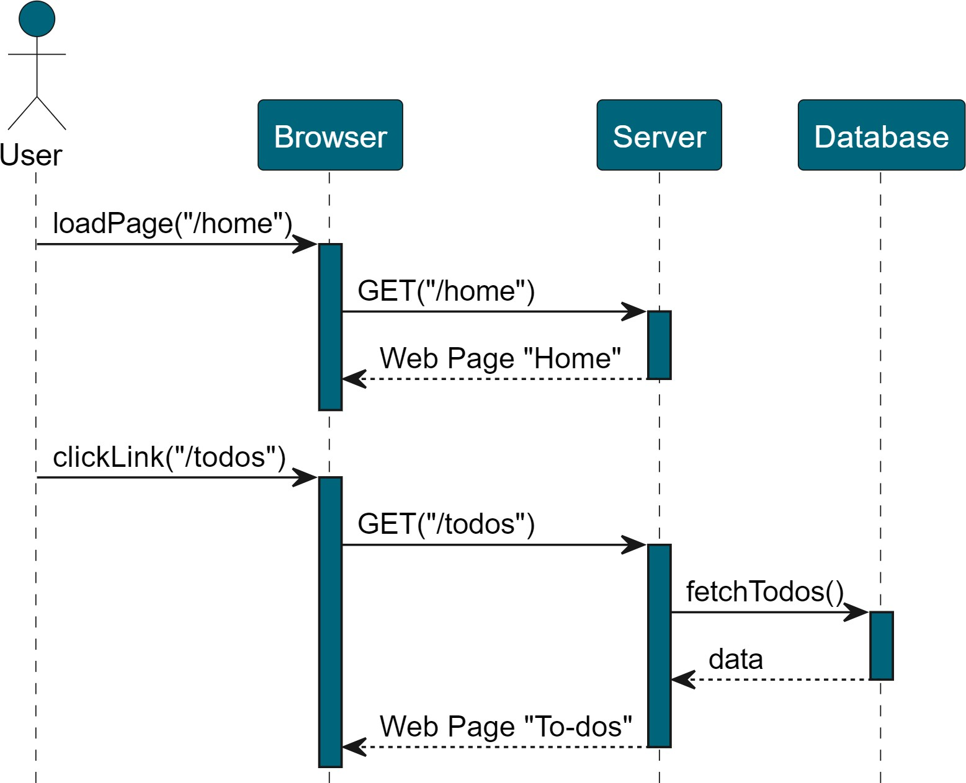
MULTI-PAGE APPLICATIONS
Navigating to a different page always triggers a full-reload of the web page

Slide 5
SINGLE-PAGE WEB APPLICATIONS
A Single-Page Application (SPA) reacts to user input by dynamically updating the content of the current page, rather than loading a new page from the server.
The entire application is loaded in the initial request, and then the page is never reloaded
The complexity of view rendering is shifted from the server to the client-side code (thin clients to thick clients)
JavaScript-intensive applications

Slide 6
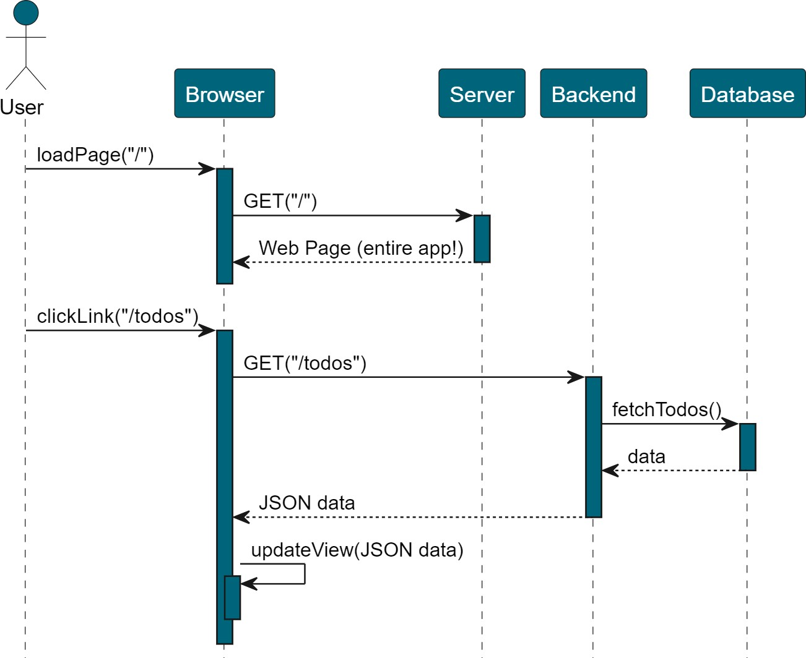
SINGLE-PAGE APPLICATIONS
Navigating to a different page does not trigger a full page reload.
Required data is fetched from a backend (e.g.: REST)
Client-side JavaScript dynamically creates the new web page

Slide 7
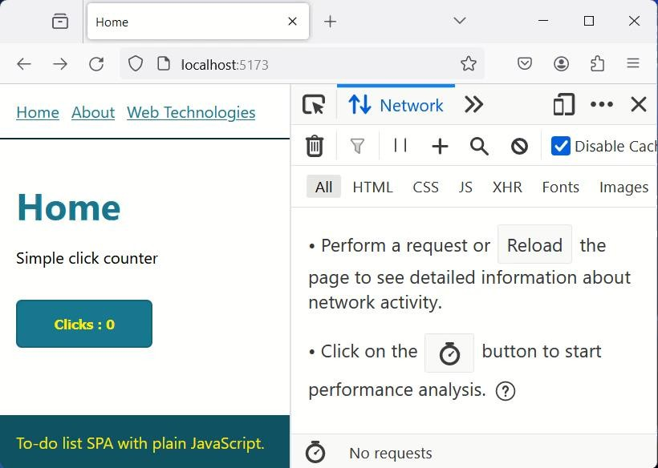


SINGLE-PAGE APPLICATIONS IN ACTION
No network requests!

Slide 8
CLIENT-SIDE ROUTING
Different «pages» in a SPA are typically referred to as views
In SPAs, navigation and view updates are managed entirely on the client-side, without reloading the entire page from the server
This practice is called client-side routing
Client-side routing involves:
Updating the Browser url
Loading and rendering the appropriate content (view) on the web page
Interact with the Browser History API to allow users to seamlessly use the back and forward buttons to navigate between different views

Slide 9
CLIENT-SIDE ROUTING
Key components of client-side routing include:
Router: module that handles the mapping between URLs and Views
View Rendering: a mechanism to render different Views
History Management: a mechanism to use the History API to manipulate the browser’s navigation history.
This is because we want users to interact with SPAs as with any other Multi- page app, and the back and forward buttons should work as intended.

Slide 10



OUR FIRST SINGLE PAGE APPLICATION
There is a single HTML document, shown below
It does not include any content at all, just an empty «app» <div>!
main.js is the one that does the heavy lifting here!
server-side
<!DOCTYPE html>
<html lang="en">
<head>
<title>Single Page Application</title>
<link rel="stylesheet" href="src/css/style.scss"/>
</head>
<body>
<div id="app"></div>
<script type="module" src="./src/js/main.js"></script>
</body>
</html>
main.js

Slide 11
TAKING A LOOK AT MAIN.JS
The main.js script starts by creating three new elements in the app
<div> container
A navbar, a container for the main content, and a footer
The navbar and the footer won’t change when switching between different views, while the content will change.
let nav = document.createElement("nav");
nav.id = "nav";
let content = document.createElement("main"); content.id = "content";
let footer = document.createElement("footer"); footer.id = "footer";
app.append(nav, content, footer);

Slide 12
TAKING A LOOK AT MAIN.JS
Then, the routes in the app are defined.
Each route associates a view to a given URL
Each route is indexed by its URL path, and is associated with
title: will be title of the page when that view is loaded
render: a function returning an HTML string rendering the view
import about from "./views/about.js"; /*other imports omitted for brevity*/
const routes = {
"/": { title: "Home", render: home }, "/about": { title: "About", render: about },
"/webtech": { title: "Web Technologies", render: contact },
};

Slide 13
TAKING A LOOK AT VIEWS/ABOUT.JS
View rendering is as simple as possible
A function returning an HTML string to be rendered for that view
It may get way more complex!
For a starter, we may use a template engine!
export default () => /*html*/`
<h1>About</h1>
<p>
This is a single page app. Navigating to different pages does not trigger a full-page reload!
</p>
`;

Slide 14
TAKING A LOOK AT MAIN.JS: ROUTER FUNC
Then, we define a router function
function router() {
let view = routes[location.pathname]; //get route corresponding to current path
if (view) { //if a route matches the current path
document.title = view.title; //update the page title to the one of the route
content.innerHTML = view.render(); //update the content with the result of
//the render function
} else { //no route matches the path
history.replaceState("", "", "/"); //replace current history entry with an
//emtpy state and change url path to /
router(); //call router() again
}
};

Slide 15
TAKING A LOOK AT MAIN.JS
Then, we populate the nav and footer elements a router function
renderFooter() is a function returning an HTML string
// Add Navigation links to the page
for(let route in routes){
let link = document.createElement("a"); link.href = route;
link.innerText = routes[route].title;
link.setAttribute("data-link",""); // notice we're adding a custom attribute!
nav.append(link);
}
// Render footer
footer.innerHTML = renderFooter();

Slide 16
TAKING A LOOK AT MAIN.JS: NAVIGATION
In a SPA, we might have links that should behave normally (e.g.: links to external websites), and links that should just trigger a view update
In our example, we identify the latters with the data-link attribute
// Handle navigation
window.addEventListener("click", e => {
if (e.target.matches("[data-link]")) { e.preventDefault(); // do not trigger page reload
history.pushState("", "", e.target.href); // add new state on history stack router(); // call router to update the view according to current url path
}
});

Slide 17
TAKING A LOOK AT MAIN.JS: NAVIGATION
Last, we take care of executing the router() function to update the view to match the current URL path
Every time the user clicks on the «back» button in the browser
popstate event on the Window interface
Every time the main web page is fully reloaded (e.g.: if the user presses the refresh button)
DOMContentLoaded event
// Update router
window.addEventListener("popstate", router);
window.addEventListener("DOMContentLoaded", router);

Slide 18
INTRODUCING COMPONENTS
As the complexity of front-ends grows, managing entire views as
monoliths becomes rapidly unfeasible
Codebase gets hard to maintain
It’s difficult to re-use pieces of functionalities in different views
Decomposing the UI into modular components is the way to go
Each component encapsulates a specific functionality
A component should be the sole responsible for rendering its UI (HTML) and managing its internal state
Views using a component should not bother about these details
Components can then be easily re-used in multiple views

Slide 19
COMPONENTS
Components play a central role in all front-end frameworks (we’ll see!)
Key characteristics of components include:
Modularity: they should be self-contained, and encapsulate a specific piece of functionality
Encapsulation: they should encapsulate their own business logic, state,
layout and styles
Reusability: they should be designed to be re-usable across different parts of the app

Slide 20

CREATING A COMPONENT FROM SCRATCH
// New component
class Counter extends HTMLElement { constructor() {
super();
this.innerHTML = `<button>Clicks : ${count}</button>`; let btn = this.querySelector("button");
// State
btn.onclick = () => {
btn.innerHTML = "Clicks : " + ++count;
};
We’re defining a new HTMLElement called <click-counter>, associated with the Counter class, using the Web Components API!
}
}
The browser will use the Counter class when a <click-counter> element is found in the DOM!
let count = 0;
customElements.define("click-counter", Counter);

Slide 21
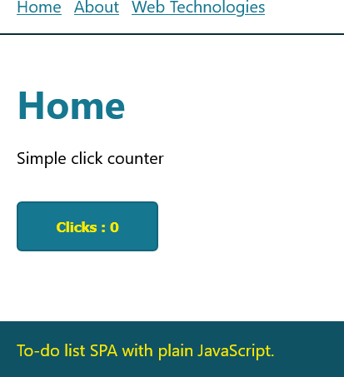
USING A COMPONENT
import "../components/counter.js";
export default () => /*html*/`
<h1>Home</h1>
<p>Simple click counter</p>
<click-counter></click-counter>
`;
class Counter extends HTMLElement { constructor() {
super();
this.innerHTML = `<button>Clicks : ${count}</button>`;
let btn = this.querySelector("button");
btn.onclick = () => {
btn.innerHTML = "Clicks : " + ++count;
};
}
}

Slide 22
WHY SINGLE-PAGE APPLICATIONS?
SPAs offer some advantages over traditional multi-page apps:
More dynamic user experience, similar to desktop apps
The initial page load is slower (need to download the entire app), but subsequent ones are way faster
Reduced server load
Only required data is fetched from the server, and only when needed.
No need to transfer entire HTML documents over and over
This can help reduce server loads and bandwidth

Slide 23
A NOTE ON FETCHING DATA
Before the Fetch API was introduced in ES6, network requests were sent using AJAX
AJAX stands for Asynchronous JavaScript And XML
AJAX was implemented using the XMLHttpRequest interface
While XMLHttpRequest is nowadays being replaced by the Fetch API, it is still quite common and you may find it in some packages

Slide 24
EXAMPLE USING XMLHTTPREQUEST
Typical workflow consisted in creating and XMLHttpRequest object
Setting a callback to execute when the request completes
Initialize a request (set HTTP method, url, whether it is async or not)
Send the request to the server
let xhttp = new XMLHttpRequest(); xhttp.onreadystatechange = function() {
if (this.readyState == 4 && this.status == 200) {
// Typical action to be performed when the response is ready: document.getElementById("demo").innerHTML = xhttp.responseText;
}
};
xhttp.open("GET", "/url/to/fetch", true); xhttp.send();

Slide 25
THE TO-DO LIST SINGLE PAGE APP
Developed from scratch using plain JavaScript!

Slide 26

THE TO-DO LIST SINGLE PAGE APP
Let’s implement our To-do List App as a SPA!
We’ll use the REST API we developed in the earlier lectures
And we’ll add a sleek SPA frontend, written in plain JavaScript
Live demo time!

Slide 27
THE TO-DO LIST COMPONENT
class TodoList extends HTMLElement {
list = []; constructor() {
super();
this.innerHTML = /*html*/;
this.list = this.fetchTodoItems().then( (res) => {
this.updateTodoList(res);
});
let btn = this.querySelector("#save-todo"); let input = this.querySelector("#todo-input"); btn.onclick = () => {/*...*/};
}
async fetchTodoItems(){/*...*/} updateTodoList(list){/*...*/ } async saveTodo(toSave){/*...*/}
}

Slide 28
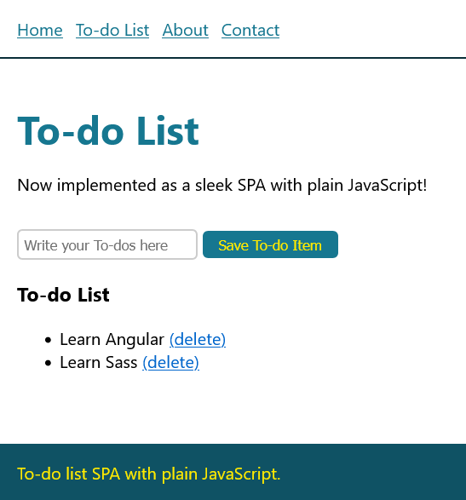
THE TO-DO LIST COMPONENT
constructor() { super(); this.innerHTML = /*html*/` <input id="todo-input" placeholder="Write your To-dos here"></input>
<button id="save-todo">Save To-do Item</button> <h3>To-do List</h3> <ul id="the-list"></ul> `; this.list = this.fetchTodoItems().then( (res) => { this.updateTodoList(res); }); let btn = this.querySelector("#save-todo"); let input = this.querySelector("#todo-input"); btn.onclick = () => {/*...*/}; //handle save todo }

Slide 29
CHALLENGES WHEN DEVELOPING SPAs
Implementing the To-do List App as a SPA from scratch was educational Despite its simplicity, we started to experience some challenges
State management. We needed to keep state and UI always updated and make sure to properly update the views after any state change
DOM manipulation. Manipulating the DOM with the document API requires lots of boilerplate code
Client-side Routing. Our router was pretty basic. What if we were to support parametric routes, redirects, etc.?
Efficient rendering. We just re-draw our entire to-do list every time. What if we wanted to be more efficient?

Slide 30
FRONTEND FRAMEWORKS
Frontend frameworks like Angular, React, Vue.js, Ember, Svelte, etc., provide some ready-made solutions to tackle these challenges
Frameworks also typically include tooling support
Generation of boilerplate code
Automate build and deployment
Each framework also provides a somewhat «standardized» way of building frontends
A developer who is used to working with a given framework will have less
issues moving to a different project using the same framework!
In the next lecture, we’ll get to know Angular 17!

Slide 31
REFERENCES
SPA (Single-page application)
MDN web docs
https://developer.mozilla.org/en-US/docs/Glossary/SPA
Single page apps in depth
By Mikito Takada
Available at http://singlepageappbook.com/ and on GitHub
Relevant parts: Modern single page apps – an overview
Understanding client-side JavaScript frameworks
MDN web docs
https://developer.mozilla.org/en-US/docs/Learn/Tools_and_testing/Client-side_JavaScript_frameworks
Relevant parts: Introductory guides: Introduction to client-side frameworks and Framework main features.

